Slide 1


Special Presentation:
Who is getting audited via HIPAA & OIG… and how they get caught; plus creating an A-Z HIPPA Program
Dr. Ty Talcott, CHPSE
C: 469.371.8804 / PH: 214.437.7559
Ty.talcott@gmail.com / Info.hipaa@gmail.com

Slide 2
Foxworth Video

Slide 3
A Little about me.

Slide 4


Slide 5


Ski Lift Acrobatics

Slide 6
How do they catch people

Slide 7
Head of Georgia legislative committee – Human Error

Slide 8
Paper protection – practice sale

Slide 9
$289,000
Will you receive that level of fine?

Slide 10
Patient Complaints
My Buddy

Slide 11
1 – 2 - 3

Slide 12
Cyber-security / Ransom Ware

Slide 13
Ledet Video

Slide 14
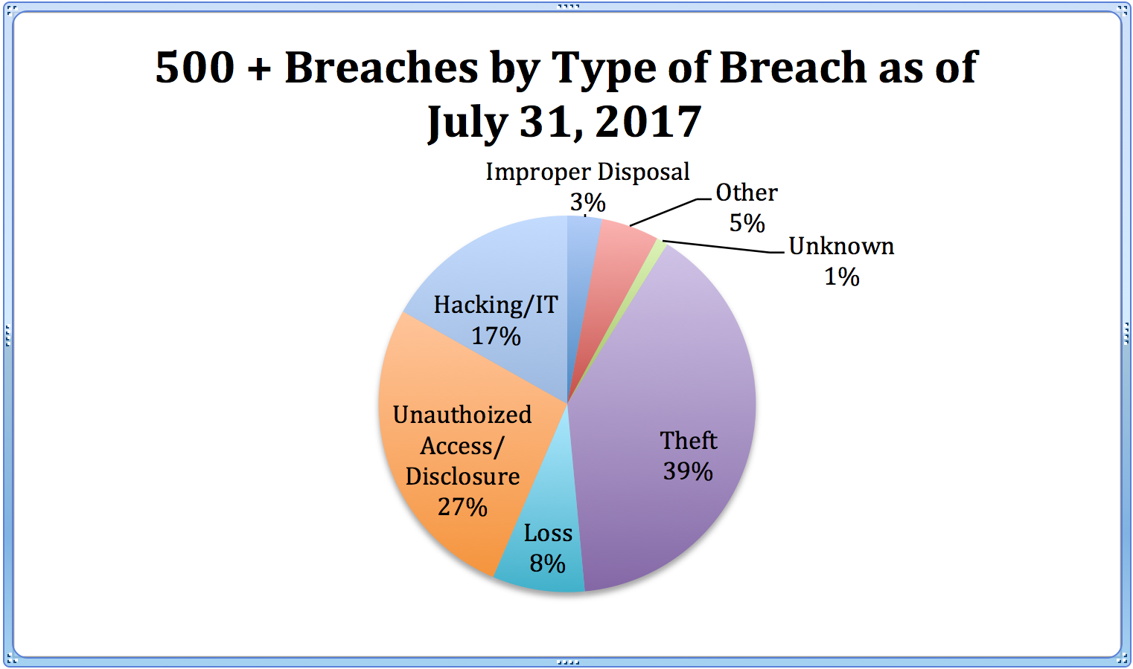

Slide 15
So, what do they do with the information?
ID theft, ins. cards, devices..
Tax returns
So, what did the government do about physician office compliance?

Slide 16
Direct from HIPAA conference
Washington DC - Sept. 2017
* Virtually every Doctor hit with
an attack/breach says the same thing,
“I thought it would never happen to me!!"
* 2017 HIPAA complaints that must be
investigated by OCR, will easily top 20K
in 2017 up 300% since 2011!!!

Slide 17
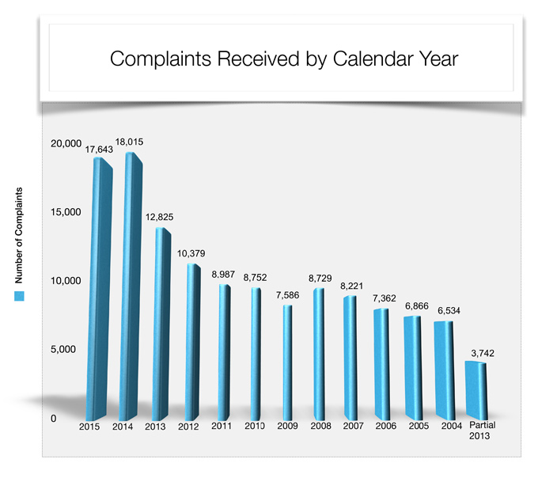

Slide 18
Huge breaches:
Target and pharmacies
Anthem Insurance = 80 million breached
Blue Cross Perma Blue = 11,000,000 breached
Now Largest HIPAA fine = 115

Slide 20
Here are some chilling quotes
taken from the official report.

Slide 21
"This portfolio presents an overview
of program vulnerabilities related to
chiropractic services in the Medicare program.
In addition, this portfolio offers recommendations
to help Medicare prevent fraud, waste,
and abuse related to those services.

Slide 22
The Centers for Medicare & Medicaid Services' (CMS's)
Comprehensive Error Rate Testing program,
...identified chiropractic services as having
the highest improper payment rates among Medicare [providers]...
* The improper payment rate ranged from
43.9 percent
to 54.1 percent, and
overpayments per year ranged from
$257 million to $304 million.

Slide 23
CMS has not implemented .. all of our
recommendations, and controls over chiropractic
services remain inadequate to prevent fraud..
This.. illustrates the need for better controls
.. to prevent beneficiaries from paying millions
of dollars in coinsurance for chiropractic
services that are not reasonable or necessary...
chiropractic services that are not reasonable
or necessary can potentially harm Medicare beneficiaries

Slide 24
Action Needed:
educate beneficiaries on the
types of chiropractic services
covered by Medicare, inform them
that massage and acupuncture services
are not covered ., and encourage them
to report to CMS chiropractors who
are providing non-Medicare-covered services;
* Chiropractors should be forced to
refund amounts overpaid by Medicare;
* Establish a threshold for the number
of chiropractic services paid .
* Establish a more reliable control
for identifying active treatment.
(you need to be plugged into updates)

Slide 25
Implement medical review for
preauthorizing certain chiropractic services.
. To provide CMS additional data,
we conducted our CY 2013 nation-wide review,
which found an 82 percent improper payment rate,
resulting in $358.8 million in overpayments..
Specifically, services in excess of 30
per beneficiary per year were all unallowable.
. In addition, our investigations and legal
actions demonstrated that chiropractic
services were susceptible to Medicare fraud.
(note: here is a where an OIG program is critical)

Slide 26
So, what do we do about it?

Slide 27
OIG compliance program is about
having a system in place to assure
that clinics filing to a federal program
do so error/fraud free.

Slide 28
The OIG seven step process:
Written policies—code of ethics, documentation, etc….
Compliance officer
Training
Effective communication
Auditing
Enforcement
Detecting offenses

Slide 29
So, let's go back to HIPAA and look
at an overview of what we have
to put in place - show extreme good
faith - to nearly bullet proof ourselves
from fines, ransom ware and/or shutting
down your business from other types
of cyber attack-- before diving in depth
on some of these issues. This is no longer
just avoiding fines.. it is about protecting
your business!

Slide 30
Overview of what a HIPAA Regulatory Compliance Manual Looks Like
[Clinic Name]
Index
1. Compliance Officer
Job Description
Notification of Officer Appointment/Posting
Policy and Procedure
Filing a complaint
2. Notice of Patient Privacy Policy - 2013 Omnibus Rules, Increased enforcement and fines

Slide 31
3. Forms
Consent to use PHI
Restricted Consent
Patient Authorization
Revocation of Authorization
Approve Request to Copy
Deny Request to Copy

Slide 32
Required Accounting Log – per patient
5. Corrective Action Forms
6. Employee Confidentiality Statements
7. Business Associate Confidentiality Contracts - 2013 Omnibus Rules, Increased enforcement and fines
8. Annual required Staff In-service training - privacy and security rules.
9. Physical Plant Audit
10. Risk Analysis
11. ISAR
12. Required Annual A-Z HIPAA program Audit/Evaluation

Slide 33
13. BONUS Audits
Claim Denial Review
Medicare ABN Compliance
Clinical File Review
14. Policies and Procedures for Security Rules
15. Required Contingency plan with data recovery and emergency mode operations
16. Required equipment maintenance log
17. Model release for testimonial use
18. Audit Schedule for 2017

Slide 34
Policies & Procedures
PRIVACY OFFICER/COMPLIANCE OFFICER
PRODUCTION OF DOCUMENTS AND DATA
RETENTION OF DOCUMENTS AND DATA
SANCTION POLICY
CONFIDENTIALITY AGREEMENTS AND B.A. CONTRACTS
SCOPE OF PROTECTION UNDER THE SECURITY RULES
APPLICABLE STATUTES / REGULATIONS
TEAM MEMBER/WORKFORCE POLICIES
PROHIBITED ACTIVITIES
SECURITY MANAGEMENT PROCESS- RISK ANALYSIS
EMERGENCY OPERATIONS PROCEDURE
EMERGENCY ACCESS
BUILDING SECURITY
ELECTRONIC COMMUNICATION
INTERNET ACCESS
REPORTING SOFTWARE MALFUNCTIONS
TRANSFER OF FILES BETWEEN HOME AND WORK OR EMPLOYEE TO EMPLOYEE
INTERNET CONSIDERATIONS
DE-IDENTIFICATION / RE-IDENTIFICATION OF PERSONAL HEALTH INFORMATION (PHI)
USER LOGON AND IDS
ACCESS CONTROL
DIAL-IN CONNECTIONS
MALICIOUS CODE
ENCRYPTION
TELECOMMUTING
SPECIFIC PROTOCOLS AND DEVICES
RETENTION / DESTRUCTION OF MEDICAL INFORMATION
DISPOSAL OF EXTERNAL MEDIA / HARDWARE
MANAGING CHANGE
AUDIT CONTROLS
BREACH NOTIFICATION PROCEDURES
CONFIDENTIALITY / SECURITY TEAM (CST)
CONTINGENCY PLAN
SECURITY AWARENESS AND TRAINING
EMPLOYEE BACKGROUND CHECKS

Slide 35
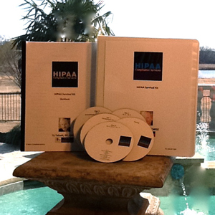

Slide 36

Special Offer Survival Kit
Retail Price of $549.00
Discounted Webinar Price of $397.00
OIG Compliance Program FREE with purchase
of any HIPAA product, from this seminar
( $399 Retail Value)
Call 214-437-7559 or
Email: Ty.talcott@gmail.com / info.hipaa@gmail.com

Slide 37
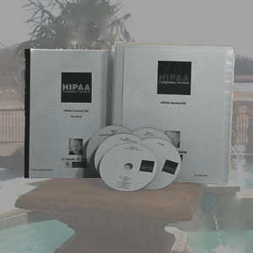
Silver Program: This is a very popular AFFORDABLE midrange service we provide for authoring your HIPAA compliance manual for you; Risk Analysis, ISAR, around 100 pages of policies, customized documents and forms, and much more required by the government. The promotional price is four payments of $449 each or a $100 discount for pay-in-full. If you have already purchased the Survival Kit, you will receive a credit toward your upgrade!
Super-Charge your Silver with HIPAA Boot Camp!
With this Super-Charged Silver Program, you receive everything in both the Survival Kit & Silver program, plus we come on-site and train your compliance officer Face-to-Face. We assist with fully implementing your HIPAA program, train your staff in person, complete a physical plant walk through/inspection and Certify your Compliance Officer. Increase your four monthly payments to $948 + Travel Expenses for HIPAA Boot Camp!

Slide 38

Break

Slide 39
Audit Schedule Detail

Slide 40
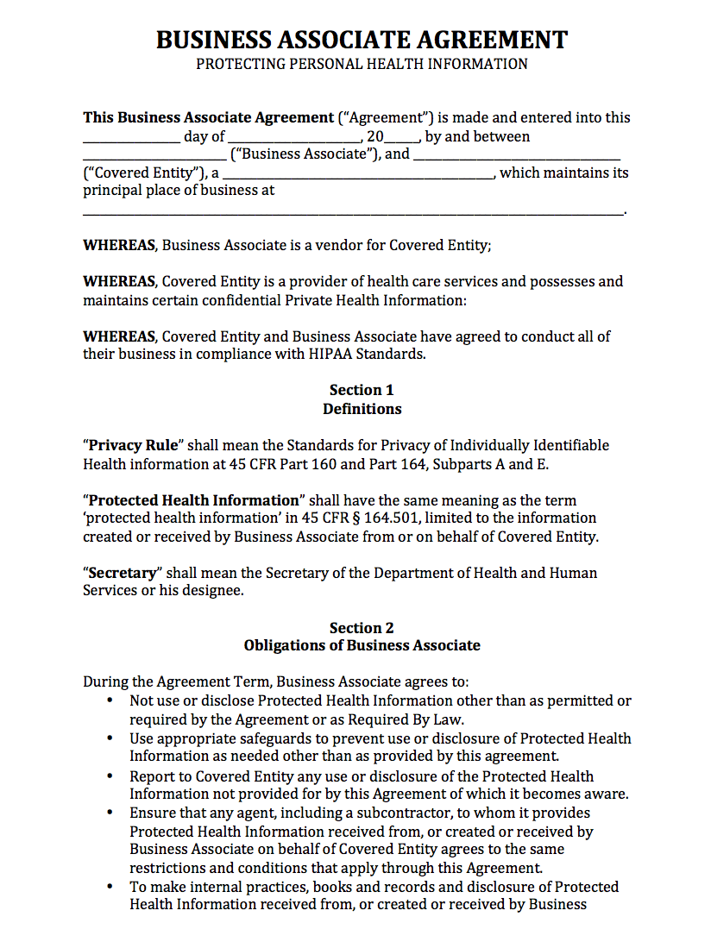

Slide 41
Privacy Posting Changes
Privacy Posting is now called the “Notice of Patient Privacy Policy”
The Policy must include that you need special releases for:
disclosures of psychotherapy notes
disclosures of Protected Health Information for marketing purposes; and
disclosures that constitute a sale of Protected Health Information; as well as a statement that other uses and disclosures not described in the Notice of Privacy Practices will be made only with authorization from the individual.

Slide 42
That an individual has a right to opt out of fundraising communications (i.e. if the Covered Entity intends to contact the individual regarding fundraising).
The right of an affected individual to be notified following a breach of unsecured Protected Health Information.

Slide 43
Good place to pause and talk about compliant fee schedules for a second.
When they look, they look…
They look at forms, postings, what you have people sign and whether that info. is protected.
Dual fee systems
Point of service
Now can NOT report to ins. if patient dictates, which can cause more scrutiny.

Slide 44
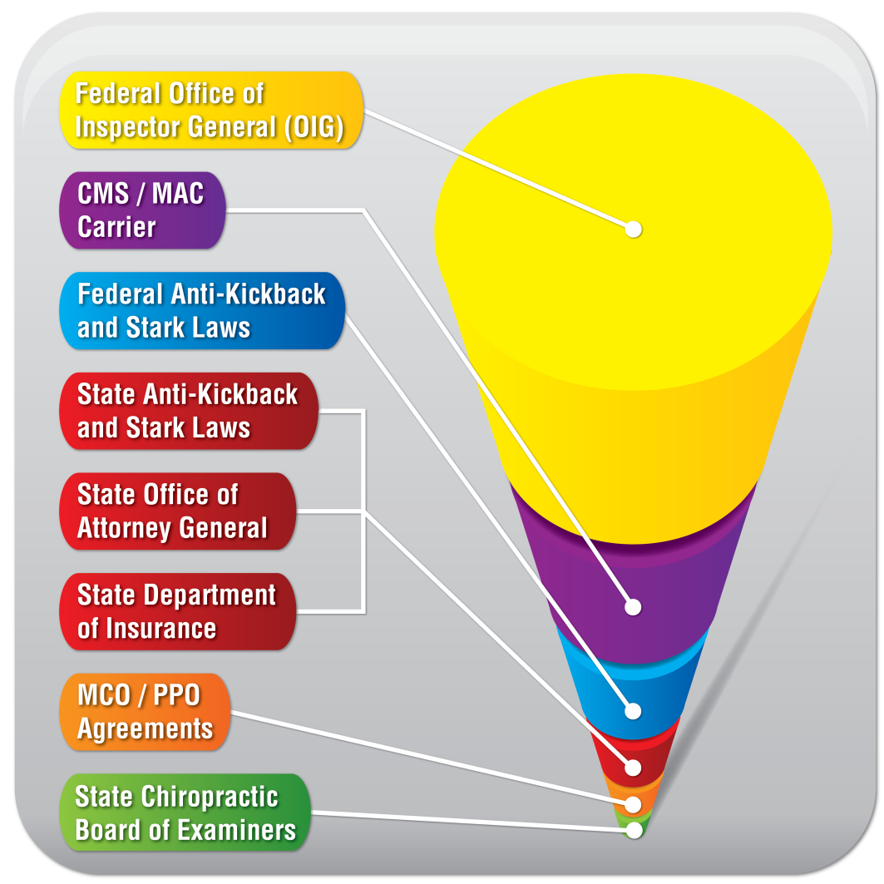
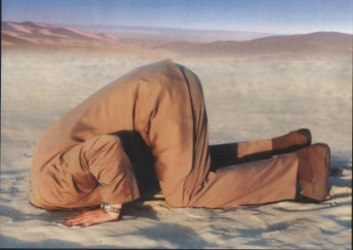
How About You?…Do You Worry?
Dual fee schedule?
Cash discounts?
OIG inducement violations
Is your financial policy legal &
compliant at all levels?
If you don’t worry, YOU SHOULD!
Better yet. Know the Rules!
To receive a Sample 1 Page Financial Policy from Dr. Foxworth, Text DRT to (601) 227-7720. This is a great tool that you can customize in your office and a step toward becoming more compliant!

Slide 45
Email Form
Alert List
CHUSA
Affordable Care Act (Obamacare)
Guides

Slide 46
Best Friend

Slide 48
Risk Analysis

Slide 49
Risk Analysis
Date performed_________ Participants______________________
Inventory of Assets that contain PHI, including key staff, business associates, etc. :
  Lap Top Computer
  On-site server
  __________, etc.

Slide 50
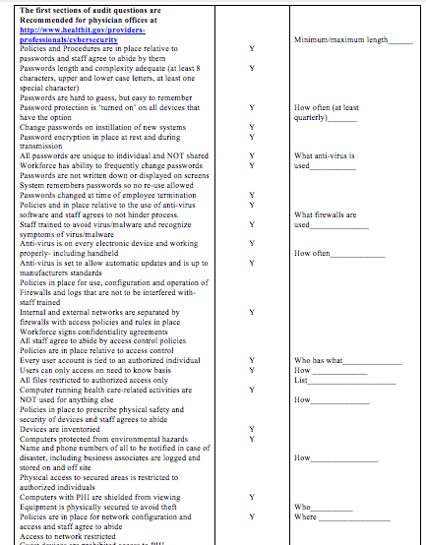

Slide 51
Item from inventory list: Lap Top computer
Threats and vulnerabilities:
1. Viruses
2. Lack of adequate policies and procedures for who uses computer - for what purposes
3. Unknown location overnight
4. No protocols to prevent unauthorized internet access
5. At risk for theft while being transported
6. Data at rest not encrypted
7. _________________ etc.

Slide 52
Present controls in place:
4. There is a policy in place to limit unauthorized utilization of the internet
5. When transported in the car the computer is to always be locked in the trunk if left in the car

Slide 53
Gap analysis - Still needed:
1. Anti Virus
2. Adequate Policies and Procedures need to be developed and trained to staff
3. System for ‘checking out’ the computer, if taken off premises, to know who has it and when it is to be returned
6. Non-encrypted data

Slide 54
Potential solutions:
1. Install anti-virus, buy new
2. Install anti-virus as ‘additional computer’ on an existing plan
3. Download anti-virus from the internet.
4. Consider McAfee, Norton, AVG, Sophos
5. Policies could be written from scratch on each individual area needed.
6. Existing Policies could be expanded to cover areas of concern.

Slide 55
7. A ‘check out system’ could be set up similar to a library card
8. One individual could be put in charge of ‘loaning out’ equipment and keeping a log of who has what, where, etc.
9. Could require the lap top never leave the office.
10. Check with IT professional for encryption solutions
11.___________, etc.

Slide 56
Mitigation of risk:
1. Download and install Norton anti-virus
2. Expand existing policies to cover areas of concern relating to who is authorized to use the equipment and check it out
3. Office manager will be in charge of ‘releasing’ the lap top for overnight only use.
6. Office manager will oversee implementation of encryption for data at rest

Slide 57
Who is going to follow up:
Office manager will assure that all components of the mitigation process are in place and functioning by ___________ , record the date of implementation on the risk analysis form and create a report detailing the new function to be placed in the hands of senior management by _______ (date).

Slide 58
The new wrinkle = Information Systems Activity Review
Added request, in addition to risk analysis, started January 2015 as a new component of meaningful use attestation audits.

Slide 59
Equipment Maintenance: Equipment is maintained by in-house IT staff_____________(name of person/persons). Any outside work needed is monitored by such person as who did what at what time and is recorded on the risk analysis form for easy review and update- as well- status of periodic testing for proper function of maintained equipment if recorded.

Slide 60
Data Recovery: In the event of loss of access to data, for any reason, restoration can take place via Carbonite cloud backup. Senior management is in possession of the process for restoration.
Emergency Mode Function: This piece of equipment is not critical for basic functions in the event of a disaster such as flood, earthquake, tornado, etc. that may interrupt or destroy function. Other office equipment can access needed data and perform functionality.

Slide 62
Special Offer Survival Kit
Retail Price of $549.00
Discounted Webinar Price of $397.00
OIG Compliance Program FREE with purchase
of any HIPAA product, from this seminar
( $399 Retail Value)
Call 214-437-7559 or
Email: Ty.talcott@gmail.com / info.hipaa@gmail.com

Slide 63
Silver Program: This is a very popular AFFORDABLE midrange service we provide for authoring your HIPAA compliance manual for you; Risk Analysis, ISAR, around 100 pages of policies, customized documents and forms, and much more required by the government. The promotional price is four payments of $449 each or a $100 discount for pay-in-full. If you have already purchased the Survival Kit, you will receive a credit toward your upgrade!
Super-Charge your Silver with HIPAA Boot Camp!
With this Super-Charged Silver Program, you receive everything in both the Survival Kit & Silver program, plus we come on-site and train your compliance officer Face-to-Face. We assist with fully implementing your HIPAA program, train your staff in person, complete a physical plant walk through/inspection and Certify your Compliance Officer. Increase your four monthly payments to $948 + Travel Expenses for HIPAA Boot Camp!

Slide 64
PERFECT PRACTICE SOLUTIONS PRESENTS:
The Simple Solution Guides
The Simple Solution Guide To Managing Medicare Madness - Navigate coding/documentation rules and regulations, maximize collections, decreased denials and avoid fines and/or other enforcement activity!!
The Simple Solution Guide To Documentation, Billing and Treatment Plans - Maximize reimbursement, meet regulatory requirements and increase patient follow through for increased collections and referrals!
The Simple Solution Guide To maximum insurance reimbursement (101) -Essential for the very survival of the practice that relies on third-party pay!
The Simple Solution Guide To Office Policies and Procedures -…. The most overlooked practice component, that causes the most staff problems! Make practice life simple and fun again!

Slide 65
The Simple Solution Guide To practice essentials for all and new doctor checklist - Find all the things that fall through the cracks - the comprehensive GUIDE for every practice relative to legal concerns, registrations, business plans and what it takes to move forward! An absolute must for a new doctor check list essential for launching a new practice!
The Simple Solution Guide To Hiring, Firing, & Teambuilding - Every experienced doctor knows the biggest opportunity and/or the biggest hassle you have revolves around personnel! This guide is essential to help hire and develop the right team! With the right team victory is yours! PERIOD!
The Simple Solution Guide To the ABC’s of Front Desk operations - It all starts and stops here! Learn approaches to handling the phone/ patients and front desk activities critical to maximize referrals/patient retention and collections.
The Simple Solution Guide To Ultimate CA Training - one of the greatest missed opportunities, in most practices, is to create the well-trained, well-rounded, cross trained, confident CA. Watch your practice supercharge to the next level!

Slide 66
Individual Simple Solution Guides at a retail price of $159 each
Receive Individual guides in electronic download format to customize forms, flyers, policies, etc.!
Purchase the ‘Eight Pack’ today! Get ALL eight Simple Solution Guides for an unbelievable event price of just $497, a savings of more than $600 off retail pricing-plus, you receive the Guides in hard copy! (And electronic download to customize forms, flyers, policies, etc. to your office!)
For more information or to order:
PH: 469-371-8804 or E: Ty.Talcott@gmail.com

Slide 67
The Simple Solution Guide To mastering consistent success consciousness - Hands-down the most important guide for personal and professional success. When this one is mastered all the others simply become facilitators to make it all happen faster!
The Simple Solution Guide To patient management for maximizing results and profit - Do you ever wonder what the practitioners do that seem to be excited about being a chiropractor and going to the practice every day? Or maybe you just want to ramp your enthusiasm a bit? Mastering the proven approaches that result in having a larger percentage of your new patients Start/Stay/Refer and pay is what produces stellar results for the patient, maximizes your profits and puts a smile on your face!
The Simple Solution Guide To managing by the numbers- Sorry to say it, but most chiropractors manage by what they “feel” is going on in the office versus utilizing the facts to move forward and progress – want to jump ahead of all the rest – this is your key!
The Simple Solution Guide To Internal Marketing- We threw in a little external marketing as well : ) But in most markets today it takes a little more elbow grease and a lot less money expenditure to produce the solid growing practice. Find out what is working today to produce multimillion dollar practices in an ever more complex practice environment!

Slide 68
Pay in full options:
___ Yes, I want to order the entire set of 12 simple solution guides for just $739 a savings of $1169
___ For the moment, I just want to buy the ‘eight-pack’, for practice Fun & Efficiency, for a total price of $497 a $775 savings!
__For now, I am interested in the ‘four-pack’, for massive Practice Growth, for just $297 a $339 savings!
Payment options:
You know what? I would rather make payments over 6 months, even though it cost a little more!
___I would like the Fun & Efficiency ‘eight-pack’ for $93 per month for six months
___I would like to the massive Practice Growth ‘four-pack’ for $58 per month for six months
___I am going for it! I want all 12 Guides for $139 per month for six months
For more information or to order:
PH: 469-371-8804 or E: Ty.Talcott@gmail.com

Slide 69
Phone & Email consulting available as an add-on to the Guide purchase. Work through at your own pace with hands-on help from Ces Soyring. Please contact us for information about pricing if you are interested in this option.
PH: 469-371-8804
Ty.Talcott@gmail.com

Slide 70
Break

Slide 71
Which chiropractors are at risk if they do
not provide translation services for 15 top,
non-English languages for their patients
to satisfy the new law enacted
October 16 of this year?

Slide 72
You must have policies/procedures relative to disposal of PHI records and all staff agree to abide by them. Need to document an audit trail to prove policies followed to complete destruction by outsourcing to a service, physically destroying or use of a software to sanitize (not recommended for USB/flash media due to sector sparing).

Slide 73
Pay special attention to disposal of problem devices like printers, fax machines that store information, flash drives, etc. NIST, at government site, is a good resource for proper disposal.

Slide 74
Physical access control
** Policies must be in place and agreed to by staff, prescribing the physical safety and security of devices. All devices must be inventoried and accounted for. All computers are protected from environmental hazards. Physical access to secured areas is limited to authorized persons.

Slide 75
I have written a P & P to cover physical safety and security of devices and have a plan to enforce same.
__YES
__NO

Slide 76
Securing electronic transmissions and network utilization
**It is required to have integrity controls and encryption in place. Policies need to be in place prescribing network configuration and who has access and all staff agree to abide by them.
Access is restricted to authorized users and devices. Guest devices may not contain PHI, no peer- to peer applications. No public instant messaging and private instant messaging-only if secured.

Slide 77
Back up and Securing Encryption methods for offsite electronic media, backup tapes, data at rest, text messaging, etc.
**Back up…policies and procedures for backup and recovery are in place and agreed to by staff, all staff understand their duties during recovery. The entire system restore process is known to at least one person outside the practice.

Slide 78
A copy of recovery plan is safely stored offsite, files that are critical are documented and listed in the backup configuration. There is a timely and regular backup schedule and every run is tested for its ability to restore data accurately. Backup media are secured or encrypted- if offsite. Back ups are unreadable prior to disposal. Multiple backups are maintained

Slide 79
**Access control policies must be in place and all staff agree to abide by (document this). What to do at termination of employee, every user account must be documented to be tied to a currently authorized individual, minimum necessary states an individual may only access what is needed to perform their work, all files must be set to allow only authorized individuals to use. Computers running health care data are not allowed for other uses.

Slide 80
Awareness training relative to these and all other issues is required (annual and ongoing).

Slide 81
Determining which audit logs to activate
Only the audit logs you will actually use and monitor are appropriate to be activated. Choosing which audits to have open is based on risk and sensitivity of data.

Slide 82
Auditing your use of logins/trails
Tracking must contain, at the least, personal ID, date, time, reason accessing (view, change, delete) and show all attempts- successful and unsuccessful.
Your logins should time out/lock out after three attempts. There should be written reports in your HIPAA manual relative to summary of logs and sanctions in place for violations.

Slide 83
Physical Plant “Walk Through” Audit
Office: ________________ Date: ______________
Area of review
Compliant - Y/N
Comments
Patient charts located in secure area.
Y/N
Names on charts protected.
Y/N

Slide 84
Information at front desk protected.
Y/N
Insurance/Collection calls not able to be heard from patient area.
Y/N
Computer screens with rapid time out/password protected.
Y/N

Slide 85
Sign in sheet does not contain health information.
Y/N
Phone messages kept in protected area.
Y/N
Charts not left in unprotected areas of office with identifiable information visible.
Y/N

Slide 86
Charts not left in exam or treatment areas after patient treatment.
Y/N
X-rays/other diagnostic tools removed after patient treatment from examination/ treatment area.
Y/N
Patient information and treatment not discussed in common areas.
Y/N

Slide 87
Recognition boards/pictures etc. do not include identifiable information.
Y/N
Privacy provided as needed based on treatment provided.
Y/N
Patient Rights accessible upon request. Staff knowledgeable about location.
Y/N

Slide 88
Blackout screens
Computer Passwords
Rapid time out screensavers
Relocation of Computers
Relocation of staff member
New Sign In sheet

Slide 89
Required In-Service

Slide 90
Here are some key points for your required In-Service.
  History of HIPAA
  Benefits of Compliance With The Privacy Laws
  Why do we need to be compliant?
  The Privacy Rule: Who Is Affected

Slide 91
Our Compliance/Privacy Officer is: _____________________________
Our Privacy Rules can be reviewed by patients, the policy is located __________.
No records are faxed, or mailed from the office unless the Compliance /Privacy Officer is notified so that proper consents and procedures can be followed.
All patient information is considered private, therefore staff is expected to:
Make sure all records are kept confidential and out of sight.
Patients are not discussed outside the office
Phone conversations are kept private and not held where other patients can hear sensitive information.

Slide 92
This office will destroy records in the following manner:
1. Burn or
2. Shred
3. Outside company
Documentation will be kept of all records destroyed and the manner of destruction.
This office will secure records in the following manner:
1.
2.

Slide 93
Disciplinary Standards & Enforcement

Slide 94
Release of Patient Information
Confidential information includes:
· Any communication between a patient and the doctor.
· Any communication between a patient and other clinical persons regarding:
All clinical data, i.e., diagnosis, treatment;
Patient transfer to a facility for treatment of drug abuse, alcoholism, mental/psychiatric problem;

Slide 95
Telephone Requests for Release of Confidential Patient Information
Medical information regarding a patient shall not be released over the telephone except when required for immediate patient care.

Slide 96
Fax Requests for Release of Confidential Patient Information
Authorization for release of medical information will be accepted through a fax machine (hardcopy is preferred). Information will be faxed to physicians' offices only and only in emergency cases and/or when the patient is in the office.

Slide 98
Special Offer Survival Kit
Retail Price of $549.00
Discounted Webinar Price of $397.00
OIG Compliance Program FREE with purchase
of any HIPAA product, from this seminar
( $399 Retail Value)
Call 214-437-7559 or
Email: Ty.talcott@gmail.com / info.hipaa@gmail.com

Slide 99
Silver Program: This is a very popular AFFORDABLE midrange service we provide for authoring your HIPAA compliance manual for you; Risk Analysis, ISAR, around 100 pages of policies, customized documents and forms, and much more required by the government. The promotional price is four payments of $449 each or a $100 discount for pay-in-full. If you have already purchased the Survival Kit, you will receive a credit toward your upgrade!
Super-Charge your Silver with HIPAA Boot Camp!
With this Super-Charged Silver Program, you receive everything in both the Survival Kit & Silver program, plus we come on-site and train your compliance officer Face-to-Face. We assist with fully implementing your HIPAA program, train your staff in person, complete a physical plant walk through/inspection and Certify your Compliance Officer. Increase your four monthly payments to $948 + Travel Expenses for HIPAA Boot Camp!

Slide 100
PERFECT PRACTICE SOLUTIONS PRESENTS:
The Simple Solution Guides
The Simple Solution Guide To Managing Medicare Madness - Navigate coding/documentation rules and regulations, maximize collections, decreased denials and avoid fines and/or other enforcement activity!!
The Simple Solution Guide To Documentation, Billing and Treatment Plans - Maximize reimbursement, meet regulatory requirements and increase patient follow through for increased collections and referrals!
The Simple Solution Guide To maximum insurance reimbursement (101) -Essential for the very survival of the practice that relies on third-party pay!
The Simple Solution Guide To Office Policies and Procedures -…. The most overlooked practice component, that causes the most staff problems! Make practice life simple and fun again!

Slide 101
The Simple Solution Guide To practice essentials for all and new doctor checklist - Find all the things that fall through the cracks - the comprehensive GUIDE for every practice relative to legal concerns, registrations, business plans and what it takes to move forward! An absolute must for a new doctor check list essential for launching a new practice!
The Simple Solution Guide To Hiring, Firing, & Teambuilding - Every experienced doctor knows the biggest opportunity and/or the biggest hassle you have revolves around personnel! This guide is essential to help hire and develop the right team! With the right team victory is yours! PERIOD!
The Simple Solution Guide To the ABC’s of Front Desk operations - It all starts and stops here! Learn approaches to handling the phone/ patients and front desk activities critical to maximize referrals/patient retention and collections.
The Simple Solution Guide To Ultimate CA Training - one of the greatest missed opportunities, in most practices, is to create the well-trained, well-rounded, cross trained, confident CA. Watch your practice supercharge to the next level!

Slide 102
Individual Simple Solution Guides at a retail price of $159 each
Receive Individual guides in electronic download format to customize forms, flyers, policies, etc.!
Purchase the ‘Eight Pack’ today! Get ALL eight Simple Solution Guides for an unbelievable event price of just $497, a savings of more than $600 off retail pricing-plus, you receive the Guides in hard copy! (And electronic download to customize forms, flyers, policies, etc. to your office!)
For more information or to order:
PH: 469-371-8804 or E: Ty.Talcott@gmail.com

Slide 103
The Simple Solution Guide To mastering consistent success consciousness - Hands-down the most important guide for personal and professional success. When this one is mastered all the others simply become facilitators to make it all happen faster!
The Simple Solution Guide To patient management for maximizing results and profit - Do you ever wonder what the practitioners do that seem to be excited about being a chiropractor and going to the practice every day? Or maybe you just want to ramp your enthusiasm a bit? Mastering the proven approaches that result in having a larger percentage of your new patients Start/Stay/Refer and pay is what produces stellar results for the patient, maximizes your profits and puts a smile on your face!
The Simple Solution Guide To managing by the numbers- Sorry to say it, but most chiropractors manage by what they “feel” is going on in the office versus utilizing the facts to move forward and progress – want to jump ahead of all the rest – this is your key!
The Simple Solution Guide To Internal Marketing- We threw in a little external marketing as well : ) But in most markets today it takes a little more elbow grease and a lot less money expenditure to produce the solid growing practice. Find out what is working today to produce multimillion dollar practices in an ever more complex practice environment!

Slide 104
Pay in full options:
___ Yes, I want to order the entire set of 12 simple solution guides for just $739 a savings of $1169
___ For the moment, I just want to buy the ‘eight-pack’, for practice Fun & Efficiency, for a total price of $497 a $775 savings!
__For now, I am interested in the ‘four-pack’, for massive Practice Growth, for just $297 a $339 savings!
Payment options:
You know what? I would rather make payments over 6 months, even though it cost a little more!
___I would like the Fun & Efficiency ‘eight-pack’ for $93 per month for six months
___I would like to the massive Practice Growth ‘four-pack’ for $58 per month for six months
___I am going for it! I want all 12 Guides for $139 per month for six months
For more information or to order:
PH: 469-371-8804 or E: Ty.Talcott@gmail.com

Slide 105
Phone & Email consulting available as an add-on to the Guide purchase. Work through at your own pace with hands-on help from Ces Soyring. Please contact us for information about pricing if you are interested in this option.
PH: 469-371-8804
Ty.Talcott@gmail.com

