Slide 1
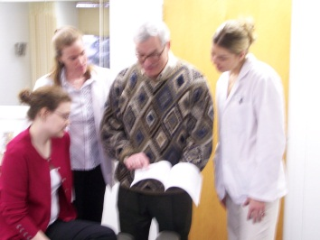
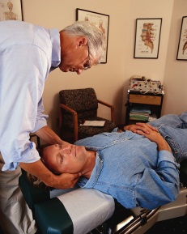
ASKING
EBP
Barbara M. Sullivan, Ph.D.
Assistant Professor
Dept. of Research
Program Manager, EBP

Slide 2
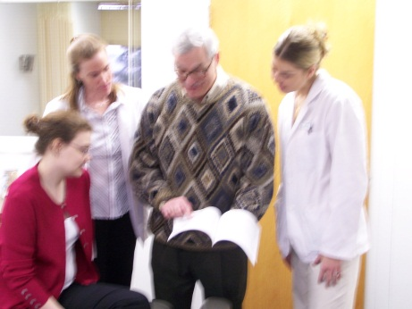
ASKING
Where does the patient focused clinical question fit in Evidence Based Practice?
EBP
Why ask a structured clinical question?
How do you ask a structured clinical question?
Where can I start to find reliable, current evidence to answer my questions?

Slide 3
Essential Evidence Based Practice
Research information
Patient values
EBP
Clinical expertise

Slide 4
Evidence Based Practice is
“… the conscientious, explicit, and judicious
use of the best evidence
in making decisions about
the care of individual patients.”
Sackett, DL, Rosenberg WM, Gray JAM, R.B. Haynes JB, Richardson WS. Evidence Based Medicine: What it is and What it isn’t. BMJ 1996; 312:71-72.
Research information
EBP
Notes:
The terms "evidence-based practice," "evidence based medicine" and "evidence-based healthcare" all revolve around using the highest quality basic and clinical research information to make a well-formed decision regarding a patient's well being. However, true evidence based practiced involves more than just using research literature to determine or support a diagnosis or therapy.
Dr. David Sackett, Founding Director of the Centre for Evidence-Based Medicine at Oxford, England emphasizes evidence-based medicine is:
"the conscientious, explicit and judicious USE of current best evidence in making decisions about the care of the individual patient.
It means integrating individual clinical expertise with the best available external clinical evidence from systematic research."
(Sackett D, William M C Rosenberg, J A Muir Gray, R Brian Haynes, W Scott Richardson. Evidence Based Medicine: what it is and what it isn't. BMJ 1996;312:71-2.)

Slide 5
Evidence Based Practice includes
“… “thoughtful identification and
compassionate use of
individual patients' predicaments,
rights, and preferences.”
Sackett, DL, Rosenberg WM, Gray JAM, R.B. Haynes JB, Richardson WS. Evidence Based Medicine: What it is and What it isn’t. BMJ 1996; 312:71-72.
Research information
Patient values
EBP
Notes:
Sackett focuses on the individual patient’s culture, rights, expectations and values in addition to research information.
Complementary and Alternative medicine also focuses on the whole patient. In fact, a recent paper in _______ a high quality, primary care centered nursing Journal examined the primary reasons why people seek alternative health care: one of the top reasons was that patients felt that CAM gave them the opportunity to participate in and control to some extent their health care decisions – this is the patient side of EBP leading to a natural union of EBP and CAM.
Ask if anyone remembers the 3rd component from the paper read last week (Sackett, BMJ What is EBP?)?

Slide 6
EBP emphasizes professional experience and clinical expertise.
"…Without clinical expertise,
practice risks becoming tyrannised by evidence,
for even excellent external evidence may be
inapplicable to or inappropriate for
an individual patient.”
Clinical expertise
Research information
Patient values
Sackett D, Rosenberg WMC, Muir Gray JA, Haynes RB, Richardson WS. Evidence Based Medicine: what it is and what it isn't. BMJ 1996;312:71-2.
EBP
Notes:
Sackett emphasized that Evidence Based Practice “ means integrating individual clinical expertise with the best available external clinical evidence from systematic research." (Sackett D, William M C Rosenberg, J A Muir Gray, R Brian Haynes, W Scott Richardson. Evidence Based Medicine: what it is and what it isn't. BMJ 1996;312:71-2.)
Note the use of the word “tyrannized, not just ruled, guided or supported by – Sackett and his team emphasize “tyrannized” for even … excellent external evidence may be inappropriate for an individual patient – again, returning to the individual patient and the need to use professional expertise to decide whether high quality evidence can be applied to the individual patient as only their physician can judge.
Sackett D, William M C Rosenberg, J A Muir Gray, R Brian Haynes, W Scott Richardson. Evidence Based Medicine: what it is and what it isn't. BMJ 1996;312:71-2.

Slide 7
Evidence Based Practice starts and ends with a
Patient
Research information
Patient values
EBP
Clinical expertise

Slide 8
5 As of Essential Evidence Based Practice
Asking a focused, “searchable,” clinical question
Accessing the medical literature through a structured search and understanding available resources
Appraising -- critically evaluating the evidence to determine if it is robust, reliable and valid.
Applying the evidence to the particular patient situation
Assessing the outcome of using (or not using) particular information its impact on clinical practice
- Mayer D. Essential Evidence Based Medicine. New York: Cambridge University Press 2004; 10.
Notes:
The philosophy of EBP is important, but what are the important skills a professional needs? There are 5 essential skills : the 5 As of EBP.
Asking the right clinical question
Accessing, searching and finding the best evidence
Critically Appraising the evidence and
Determining whether to Applying it to a particular patient
And then to assess the impact for the overall, long term picture, asking does the evidence support your decision or will it cause you to change your practice?

Slide 9
Asking a focused, “searchable,” clinical question
Captures what you need to know
Based on actual patient scenarios
Form the right question using a format that facilitates finding.

Slide 10
PICO Format Facilitates Finding Answers
Include four essential components:
P:
I:
C:
O:
Patient, population
Intervention or therapy
Comparison, control, context
Outcome
Notes:
Patient
Intervention
Therapy
Outcome
Background from the Center for Evidence Based Medicine http://www.cebm.net/: One of the fundamental skills required for practicing EBM is asking a well-built clinical question that is directly relevant to patients' problems. It must be phrased to direct the search to relevant and precise answers. In practice, well-built clinical questions usually contain four elements, summarized below.
One of the benefits of careful and thoughtful question-forming is that the search for evidence is easier. The well-formed question makes it relatively straightforward to elicit and combine the appropriate terms needed to represent your need for information in the query language of whichever searching service is available to you.
Once you have formed the question using the PICO structure, you can think about what type of question it is you are asking, and therefore what type of research would provide the best answer.

Slide 11
PICO Why use a specific format?
Focus what you need to know
Format facilitates finding
PICO components are:
Key words for text searches
“Data fields” for literature database searches
Notes:
Patient
Intervention
Therapy
Outcome
Background from the Center for Evidence Based Medicine http://www.cebm.net/: One of the fundamental skills required for practicing EBM is asking a well-built clinical question that is directly relevant to patients' problems. It must be phrased to direct the search to relevant and precise answers. In practice, well-built clinical questions usually contain four elements, summarized below.
One of the benefits of careful and thoughtful question-forming is that the search for evidence is easier. The well-formed question makes it relatively straightforward to elicit and combine the appropriate terms needed to represent your need for information in the query language of whichever searching service is available to you.
Once you have formed the question using the PICO structure, you can think about what type of question it is you are asking, and therefore what type of research would provide the best answer.

Slide 12
PICO: Focused Clinical Question
Center for Evidence Based Practice http://www.cebm.net/focus_quest.asp
Patient, population, problem
Intervention
Comparison
Outcome
Consider
Describe relevant patient characteristics or problem similar to your patient’s.
Be brief, clear, precise, narrow.
Define alternatives.
Determine possible prognostic factors, causes.
Broad (“what is most effective?”) or narrow (specific therapy).
Alternative therapy.
Consider a limiting factor
Compared to a “gold standard”.
Clinical outcome or goal: what do you want to accomplish?
What effect do you hope to have? cure, diagnosis, cost, quality of life
Be specific.
PICO
Notes:
Once you have formed the question using the PICO structure, you can think about what type of question it is you are asking, and therefore what type of research would provide the best answer.
One of the benefits of careful and thoughtful question-forming is that the search for evidence is easier. The well-formed question makes it relatively straightforward to elicit and combine the appropriate terms needed to represent your need for information in the query language of whichever searching service is available to you.

Slide 13
Start with a good question to focus your efforts.
Background questions – general information
Question root (who, what, when, why, how…)
Specific concept: intervention, comparison alternative disorder or disease, or aspect of the disorder
Fewer PICO components
Broader = greater # results from search
More “information” at various scientific levels
Patient information, overviews, reviews, etc.

Slide 14
Start with a good question to focus your efforts.
Foreground questions – specific evidence
Patient or population focused
Specific intervention with specific comparison
Clinically relevant outcome
More PICO components = fewer, more relevant results

Slide 15
Evidence Based Practice begins with a patient and a patient oriented, clinical question
Patient scenario
James, 32 year old male, technical sales manager who drives long distances (or at least for long periods of time) and is a frequent flier for his job, has been visiting you for neck and back issues for over two years on a fairly regular basis. In addition to working from the car and plane, he has a home office and uses a laptop. You and he have discussed work place ergonomics as well as exercise and stretching to alleviate chronic neck and back pain.

Slide 16
Evidence Based Practice begins with a patient and a patient oriented, clinical question
On a recent visit, he tells you he heard on the TV news that chronic back and neck pain causes depression -- or was it vice versa? -- and that chiropractic and alternative care that relieves the pain can relieve depression. He asks, “Do you think that this neck thing could be causing me to feel blue lately? Or do you think mid-winter blues are causing this pain in my lower back and neck? My colleague just had lumbar disk surgery and feels great. I’m not so excited about surgery. Should we be doing something different?”
He says after hearing that news report, he’s been looking on the internet to see what might help with the chronic pain and lift his mood.

Slide 17
PICO: Focused Clinical Question
Center for Evidence Based Practice http://www.cebm.net/focus_quest.asp
Patient, population, problem
Intervention
Comparison
Outcome
Adult (male)
Chronic back, neck pain
Headache
Insomnia
Mood, emotion
Alternative therapies
Conservative care
Botanicals
Massage
Chiropractic
Acupuncture
“Gold standard” or common therapy?
Surgery
Prescribed drug therapy?
Reduce / relieve pain
Alleviate symptoms of mild to moderate depression
Improve mood
Reduce inflammation
Question components
PICO
Notes:
What key words would you use to compose a question to help you search for the right evidence?
You can be broad and compose a background question – or narrow and compose a specific foreground question, depending on the type of information you need to answer your question.

Slide 18
PICO: Focused Clinical Question
Background questions – general information
What are [O = physical symptoms] associated with [P = chronic stress OR chronic low back pain OR chronic neck pain]?
Does [O = stress] cause [P = chronic (low back or neck) pain]?
What are [I = alternative therapy / therapies] for [P = chronic (low back OR chronic neck) pain] other than [C = surgery OR exercise]?
Foreground questions – specific evidence
For [P = adults with chronic back OR neck pain] does [I = CAM provide effective therapy] to [O = alleviate pain] compared to [C = surgery]?
[I = specific therapy: chiropractic, exercise, etc.]

Slide 19
PICO: Focused Clinical Question
Focus on what you need to know
Substitute PICO components (think of synonyms or alternatives) to provide alternative search “paths”

Slide 20
Focus Background Questions to Searchable, Foreground Format
Use great informational and “compiled evidence” websites and databases through the NUHS LRC web page
Focus background questions to searchable foreground questions

Slide 21
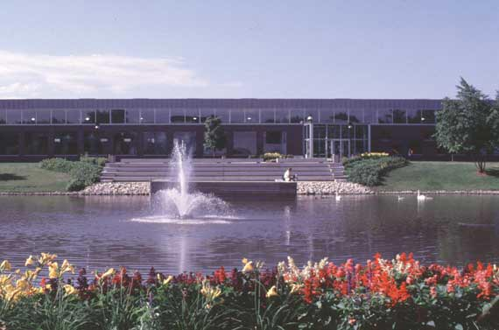
Focus Background Questions to Searchable, Foreground Format
NUHS LRC web pages: NUHS home >> Student Services >> Learning Resource Center: (click on databases) http://www.nuhs.edu/show.asp?durki=216

Slide 22
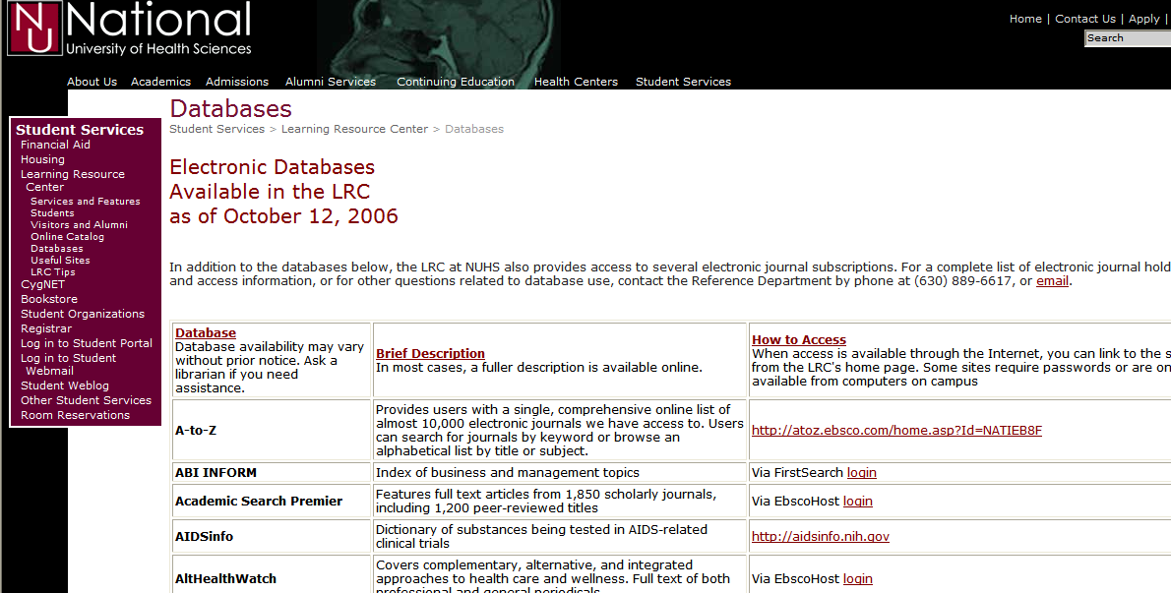
NUHS LRC web page >> databases
http://www.nuhs.edu/show.asp?durki=216

Slide 23
Compiled Evidence Websites & Databases
NUHS LRC database web page
http://www.naturalstandard.com/
NUHS LRC database web page
http://www.naturalmedicines.com/member_home.asp /
Agency for Healthcare Research and Quality http://www.ahrq.gov/
US Nat’l Library of Medicine / National Institutes of Health http://www.nlm.nih.gov/medlineplus

Slide 24
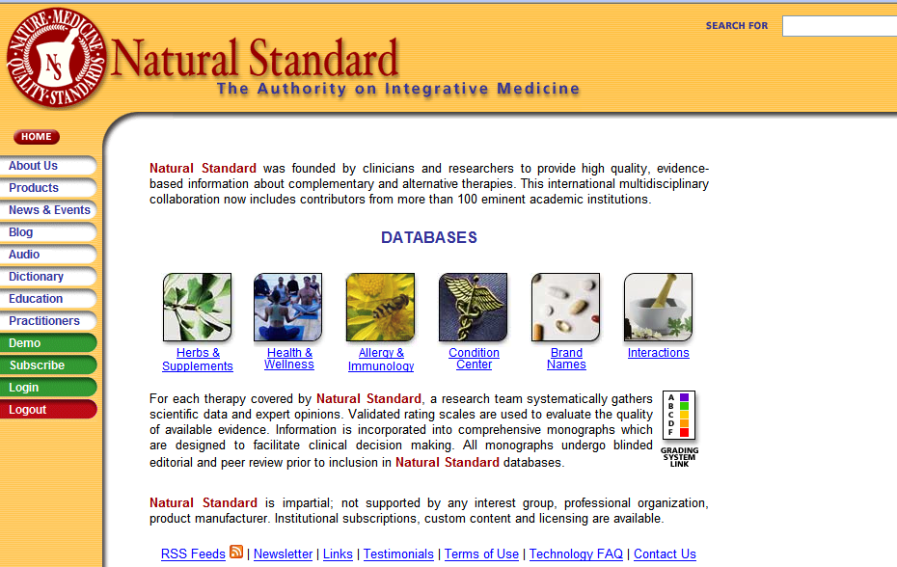
NUHS LRC >> databases >> Natural Standard
http://www.naturalstandard.com/ from on campus only

Slide 25
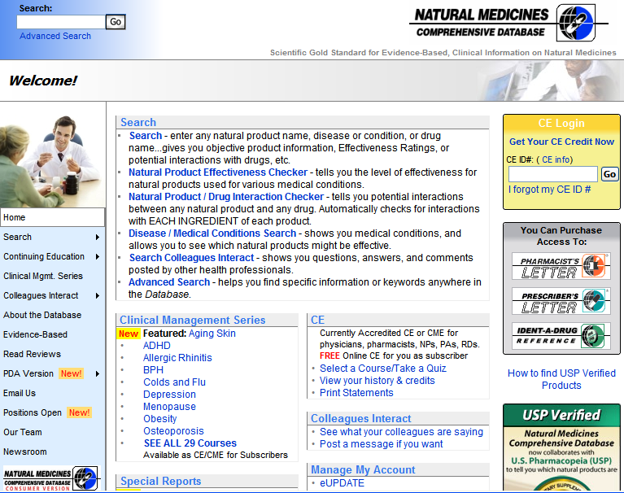
NUHS LRC databases >> Natural Medicines www.naturalmedicines.com/member_home.asp

Slide 26
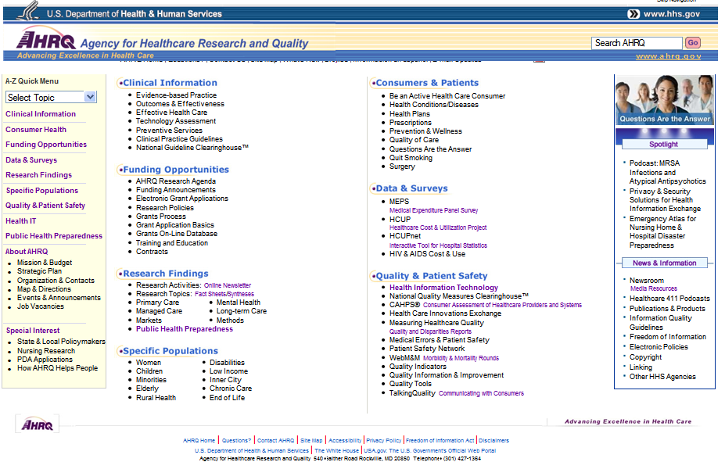
US federal Agency for Healthcare Research and Quality (AHRQ) www.ahrq.gov >> Clinical Information>> EBP

Slide 27
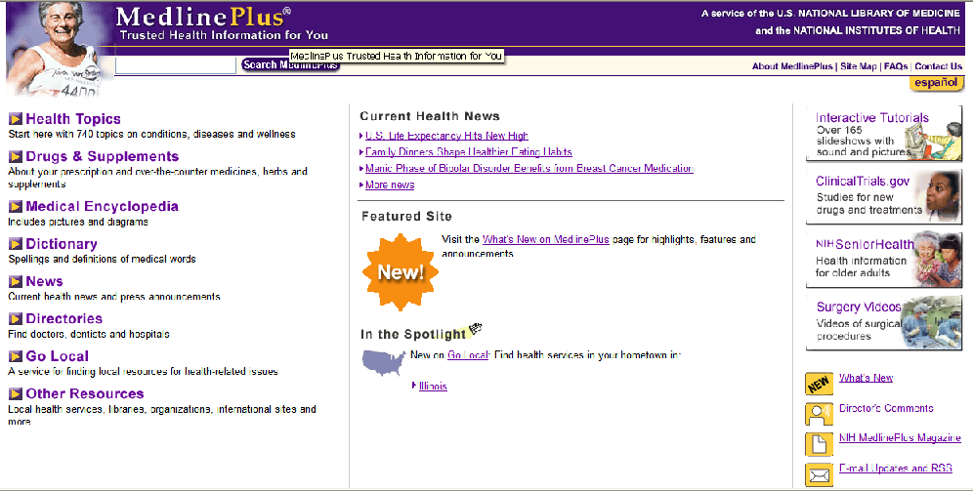
The US National Library of Medicine’s MedlinePlus (www.nlm.nih.gov/medlineplus/)

Slide 28
Hierarchy of Evidence for Clinical Decision Making
Systematic Reviews (SR),
Meta-Analysis
1a
Best Evidence / Evidence Guidelines & Summaries
1b
Randomized, controlled trials (RCT)
2a
2b
Clinical trials, Cohort Studies
3a
3b
Case Control, Case series
4
Case study / case report
5
Animal studies, in vitro studies
6
Expert opinions, editorials, ideas
Notes:
“hierarchy” infers one is better than another
Looking at the classic pyramid – what is best? SRs, MA, RCTs
Rcts considered the gold standard
But EBP uses the pyramid in a different way”
One of the bases of EBP is expertise
Volume or # of bottom lit
And strength – lead to other studies, support other studies
Add the CEBM “levels” – reliability, generalizability,

Slide 29
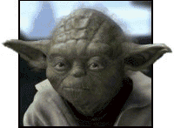
Try this activity
Follow guide & directions in Chapter 2 of the EBP@NUHS Study Guide
Use patient scenario or a hot topic of interest, form background and foreground PICO format clinical questions
Explore all the compiled evidence database websites for background information and foreground specifics
Links can be found on the NUHS LRC Database web pages or in the CygNET based EBP@NUHS
Natural Standard & DCConsult may have campus access only through IP address recognition – check the LRC passwords list if links do not open
Determine if there are other PICO component words can be used as search terms for other databases based on what’s available in the compiled evidence database websites

Slide 30
Access forms, files, links & resources for Asking
CygNET registration:
e-LRC electronic LRC resources & EBP tools
www.NUHS.edu >> Current Students >> Log into CygNET Learning Management System (http://cygnet.nuhs.edu)
Sign in with NUHS ID and password
No enrollment key

Slide 31
Try this activity – some practical outcomes & uses
Turn in PICO form with clinical question and PICO Search Strategy & Results
Use the evidence to update course material and resources – stay current efficiently
Start or contribute to an EBP@NUHS or CygNET forum:
post PICO questions – what do you need to know?
review compiled evidence website resources that
provide evidence to answer the question or
add additional, evidence based resources for study and additional, current course content

Slide 32
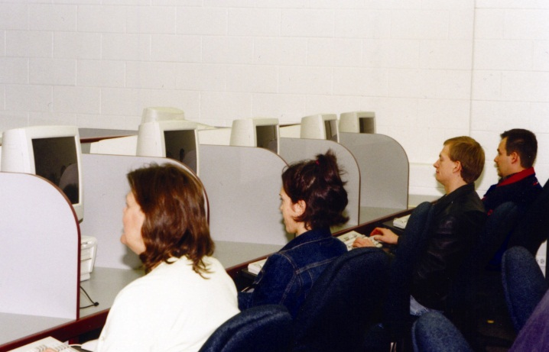
Some notes and tips
Forms, files and resource links are all on CygNET EBP@NUHS in the Asking topic
Open a file, save to your hard drive with a new file name
Working without saving to a local drive uses the CygNET server
SLOW… can lose your work
“Personalize” forms by adding PICO components, dates or initials to the original file name & keep for reference

Slide 33
Some notes and tips
Use Internet Explorer
Some browsers do not support features or have security features which block links and addresses (Mozilla Firefox)
Open links in “New Windows” if Tabs block URL addresses

Slide 34
ASKING
Have fun Asking
clinical questions

